Slide 1

Andanje SOFTWARES TECH CO.
PITCH DECK BUSINESS SOLUTION
Telephone
Address
Website
August 16
+254115348341
001, Nairobi-Kenya
https://expense-tracker-backend-api-endpoints.netlify.app/

Slide 2

TABLE OF CONTENT
PITCH DECK PRESENTATION
01
About Us
02
What We Believe
03
Market Size
04
Problems & Solutions
Andanje Softwares ltd

Slide 3

ABOUT US
GET TO KNOW US BETTER
Welcome to Andanje Softwares, where innovation meets excellence. We are a forward-thinking technology company dedicated to delivering cutting-edge software solutions that drive efficiency and growth for businesses worldwide.

Slide 4

What We Do
We specialize in a diverse range of software solutions, including custom software development, system integration, and digital transformation services. Our team of skilled professionals is committed to developing robust, scalable, and user-friendly software that addresses the challenges of modern businesses.
OUR MISSION
At Andanje Softwares, our mission is to empower organizations by providing them with state-of-the-art software solutions tailored to their unique needs. We strive to enhance productivity, streamline operations, and foster innovation through our advanced technology and expert insights.

Slide 5

DECENT WORK AND ECONOMIC GROWTH
WE WILL SOLVE THE PROBLEMS
01
Lack of Access to Modern Accounting Tools
Many SMEs rely on outdated or manual accounting methods, leading to errors and inefficiencies.
02
Insufficient Financial Literacy
03
Ineffective Financial Planning
Business owners and employees often lack the necessary skills and knowledge to effectively manage finances and accounting
Without accurate and timely financial data, SMEs struggle to make informed business decisions and plan for future growth.

Slide 6



SOLUTIONS
01
Implementing Accounting Software:
SOLUTIONS OF THE PROBLEMS
Develop and promote user-friendly accounting software tailored to the needs of SMEs, enabling them to automate and streamline their accounting processes.
02
Financial Literacy Programs:
Use data to identify gaps in financial literacy among SME owners and employees and design targeted training programs to enhance their accounting skills and knowledge.
02
Real-Time Financial Analytics:
Provide SMEs with tools that offer real-time financial analytics and reporting, allowing them to make informed decisions based on accurate and up-to-date financial data.
Thynk Unlimited

Slide 7

OUR SERVICE
Andanje Softwares ltd
WHAT WE COULD DO
. Cash Flow Management Solutions:
Develop data-driven tools that help SMEs manage their cash flow effectively, providing insights into cash flow patterns and offering recommendations to maintain a healthy cash balance.
By utilizing data and modern accounting technology, Andanje Softwares Tech Company can support SMEs in improving their accounting practices, leading to more efficient operations, better financial decision-making, and ultimately contributing to economic growth and job creation in line with SDG.

Slide 8

MARKET SIZE
Total Available Market (TAM)
TAM=
100,000xbusinesses×$500per business=$50,000,000
OUR CLIENTS COME FROM EVERYWHERE
With a global perspective, our marketing agency has proudly served multinational clients, delivering tailored strategies that transcend borders and cultures, ensuring consistent brand success on a worldwide scale.

Slide 9

BUSINESS MODEL
Value Proposition:
What: Andanje Softwares offers cutting-edge, custom software solutions designed to enhance business efficiency, drive digital transformation, and solve complex technical challenges.
Why: Companies choose Andanje Softwares for its tailored approach, innovative technology, and commitment to delivering high-quality, scalable software that meets their unique needs.
OUR BUSINESS MODEL

Slide 10
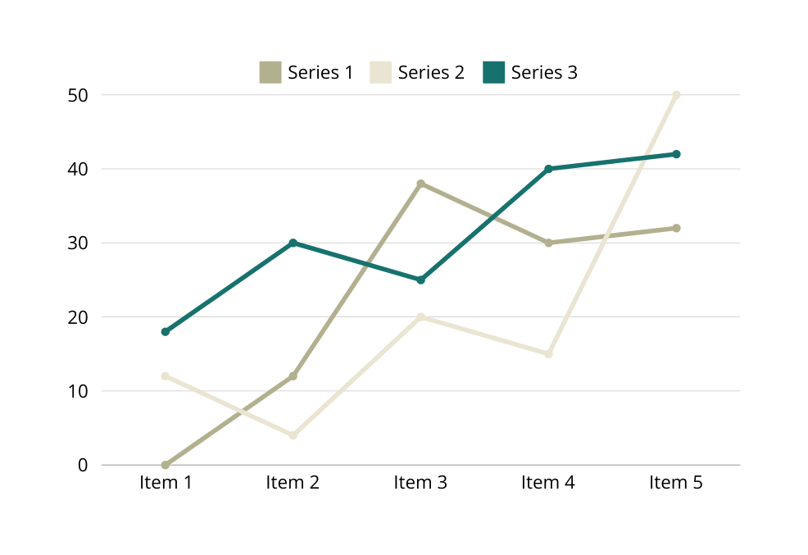

STATISTIC
CLIENT’S SATISFACTION
Client satisfaction is crucial for any tech company, including Andanje Softwares, as it drives repeat business, referrals, and overall success. Here’s a comprehensive approach to ensuring client satisfaction:
Delivering Quality Solutions
High Standards: Adhere to best practices in software development, including rigorous testing and quality assurance.
Innovative Technology: Utilize the latest technologies and methodologies to deliver cutting-edge solutions.

Slide 11
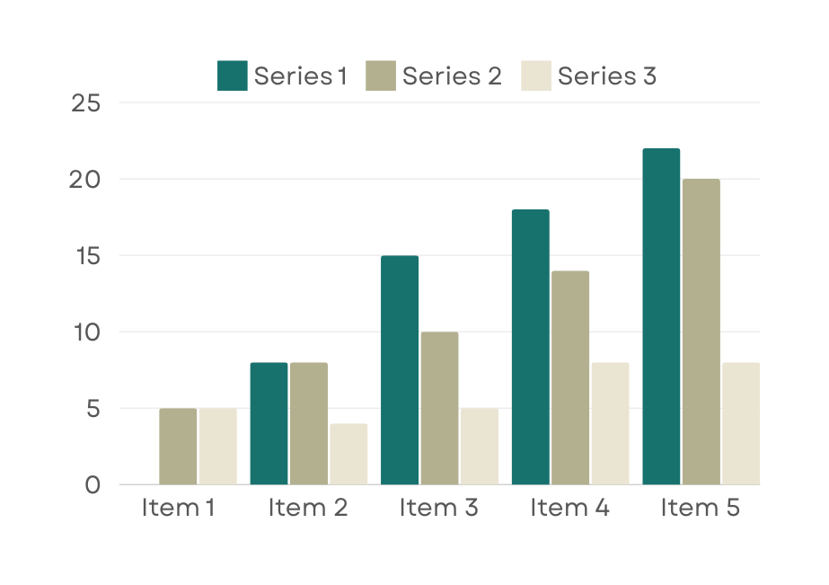
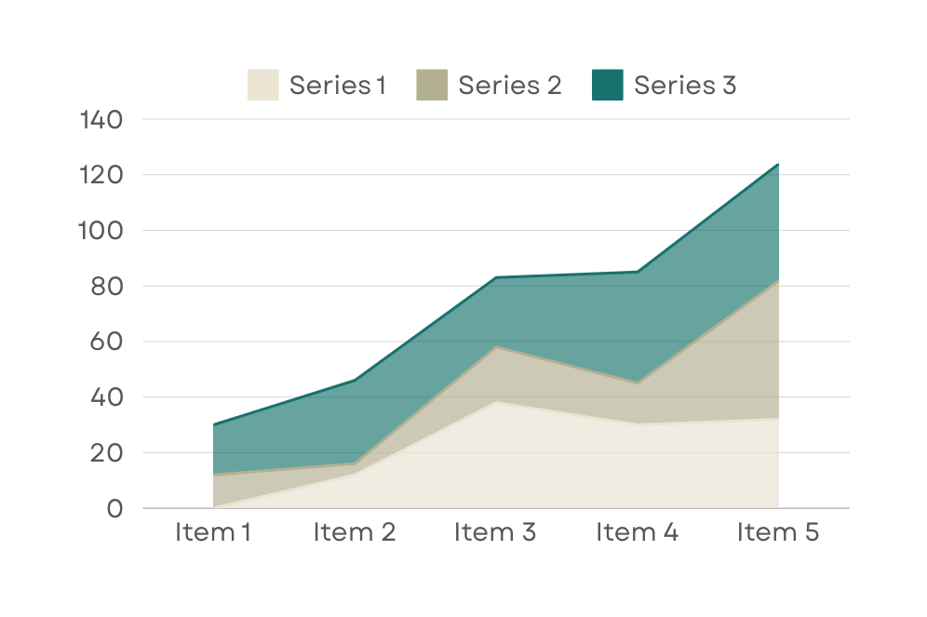
STATISTIC
Our Customer’s Satisfaction
Repeat Order Rate
An impressive client satisfaction rate underscores our unwavering commitment to delivering exceptional service and exceeding expectations.
Our remarkable client repeat order rate of 123 times are testament to the quality of our products/services and the trust our clients place in our ability.

Slide 12


STATISTIC
CLIENT’S SATISFACTION
At the heart of our success lies the unwavering satisfaction of our clients. We take pride in fostering lasting partnerships, consistently exceeding expectations, and delivering results that not only meet but surpass the unique objectives of each client we serve.
CLIENT’S REPEAT ORDER
90% | Our client loyalty speaks volumes as evidenced by a robust repeat order rate
99% | Our paramount focus on client satisfaction is the bedrock of our agency's success.
90%

